Slide 1
Applied Data Science Capstone
The Battle of Neighborhoods

Slide 2
New York Data
New York, is the most populous city in the United States. New York City is also the most densely populated major city in the United States. Located at the southern part of the U.S.
New York City is a global hub of business and commerce, as a center for banking and finance, retailing, world trade, transportation, tourism, real estate, new media, traditional media, advertising, legal services, accountancy, insurance, theater, fashion, and the arts in the United States.
New York City's food culture includes an array of international cuisines influenced by the city's immigrant history.

Slide 3
Objectives
The aim of this report is to study and analyze the neighborhoods Indian restaurants of new York city group them into similar clusters and, to analyze those clusters to gather meaningful information.
That information can be used to find out neighborhoods that are same as your current neighborhood or at least similar.
This information provided by this report would be useful for people who are interested in searching for Indian restaurants that are highly similar to their existing neighborhood.

Slide 4
Problem Description
There are many resturants in New york City, each beloning to different categories like Chinese , Indian , French etc.So as part of this project , we will list and visualize all major parts of New York City that has great indian resturants.
Queries that can be answered using above dataset.
What is best location in New York City for Indian Cuisine?
Which areas have potential Indian Restaurant Market?
Which all areas lack Indian Restaurants?
Which is the best place to stay if I prefer Indian Cuisine?

Slide 5
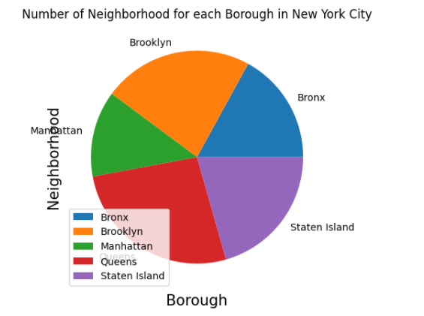
Number of neighbourhoods in New York City

Slide 6
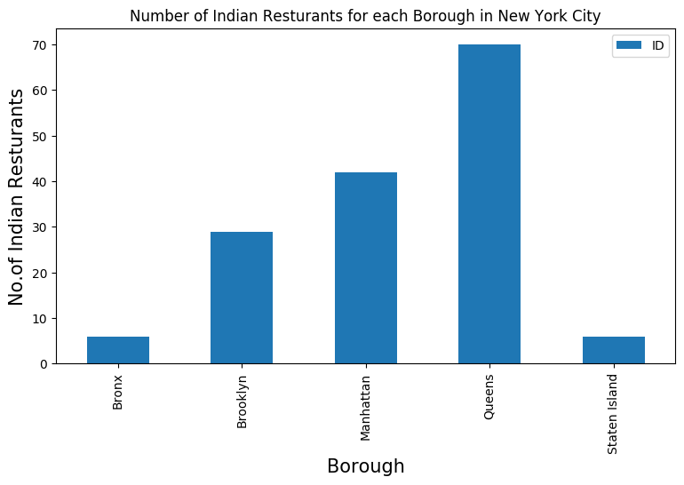

Slide 7
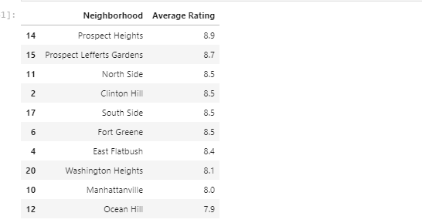
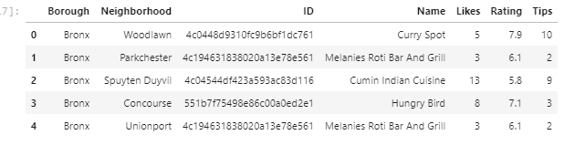
Analysis of each Neighborhood

Slide 8
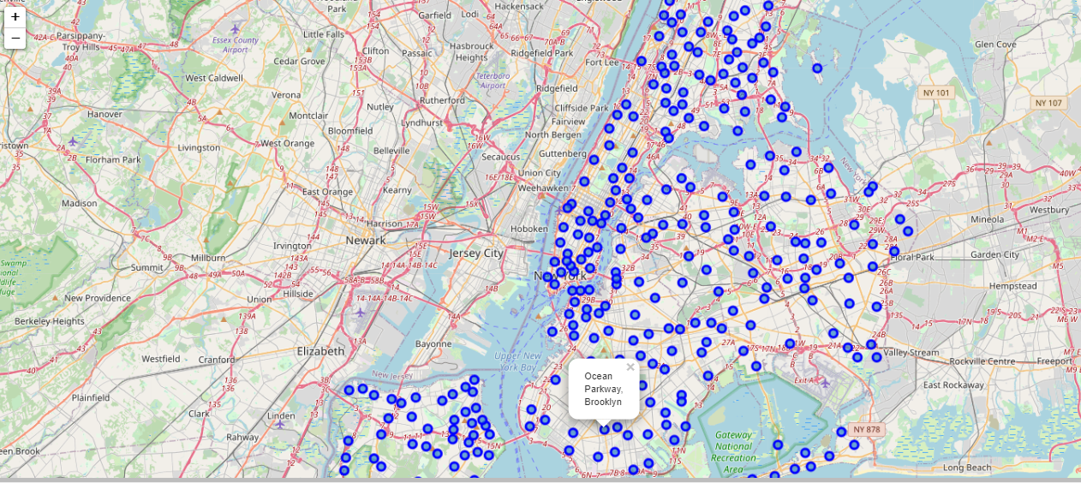
Matplotlib and folium packages to visualize the clusters on a map of New York.

Slide 9
Conclusion
There are many real life problems or scenarios where data can be used to find solutions to those problems.
To predict the best place in New York to open a new Indian Restaurant.
Capture the most restaurants of Chinese, French, Indian and all kind of food in New York City.
To predict which is the more Cuisine are located in New York City based on the food.

